Slide 1
Leveraging R for Real-Time Data Analysis and Reporting in the AI+HI Paradigm
Hao Chen
Data Intelligence, Scientific Programming, Beigene
Mar 2024

Slide 2
DISCLAIMER
The perspectives and opinions presented in this document, along with the accompanying presentation and slides, are solely those of the author and do not represent the views of BeiGene. The analysis conducted in this document is based entirely on publicly available or dummy data, and BeiGene makes no representation regarding the accuracy or reliability of the information provided.

Slide 3
01.
Background
02.
AI Progress
03.
The Power of R
04.
Case Sharing
05.
Discussion

Slide 4
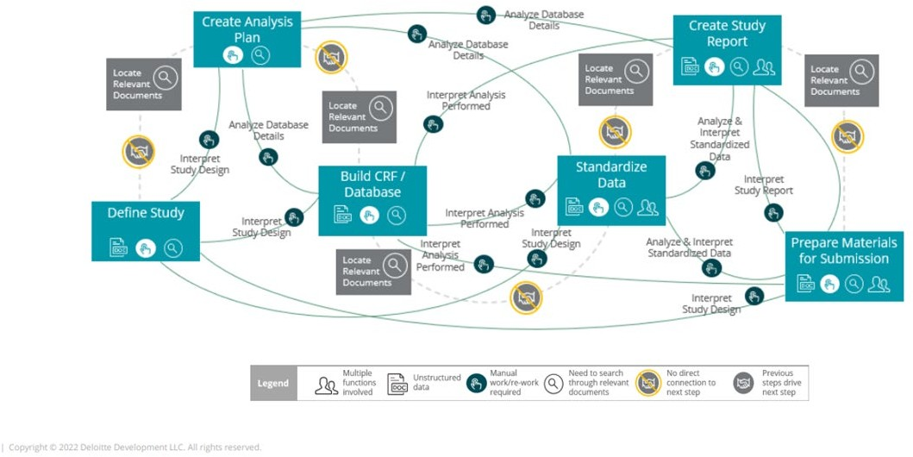
Current Clinical Data Analysis Flow
ConvergeHEALTH | Using AI to automate clinical data, from protocol to submission
Using AI to drive automation for clinical data, from protocol to submission

Slide 5
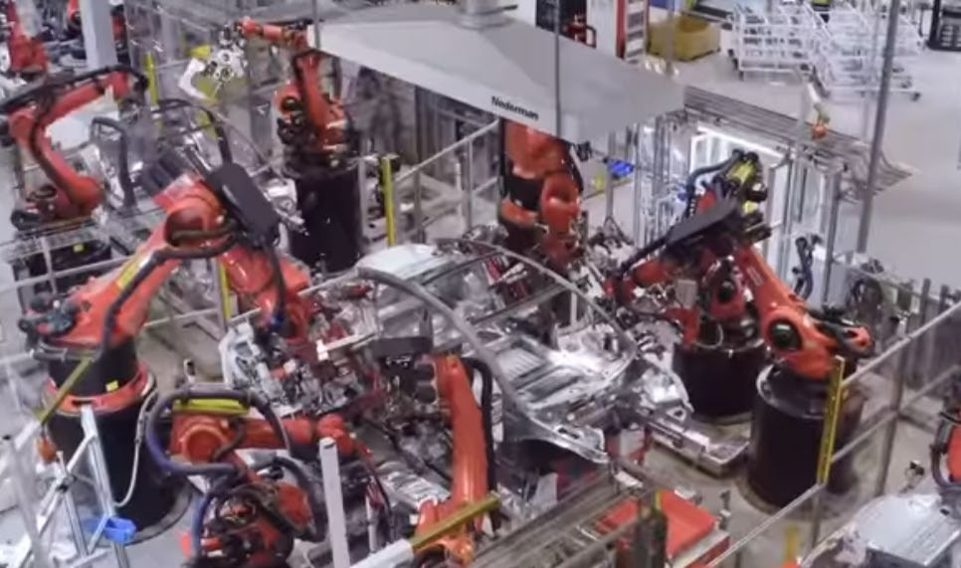
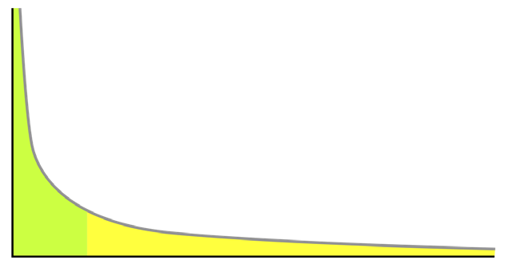
The Challenge
Manufacturing Process
Transportation System
Tesla Gigafactory 3 Shanghai
https://www.youtube.com/watch?v=-Ds1xV7M2gI
100% repeatable process
Machine is the center
Defective product destroyed
6
Pony.ai self-drive
https://www.youtube.com/watch?v=jKFV7qjWaD4
Always change
Human in the loop
Corner case matters
Long tail

Slide 6
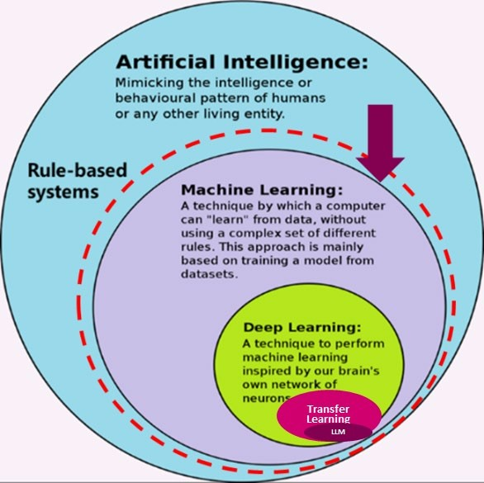
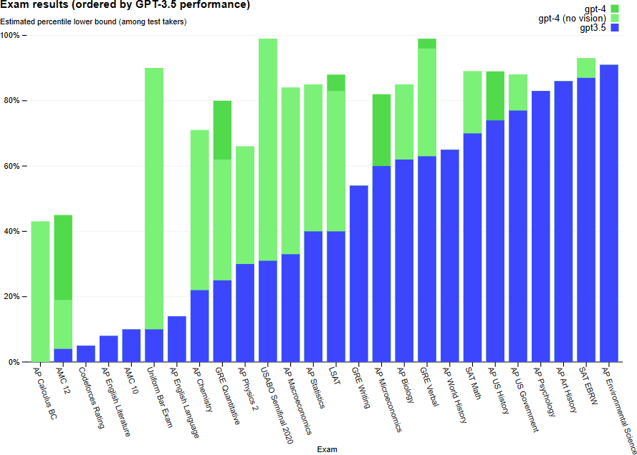
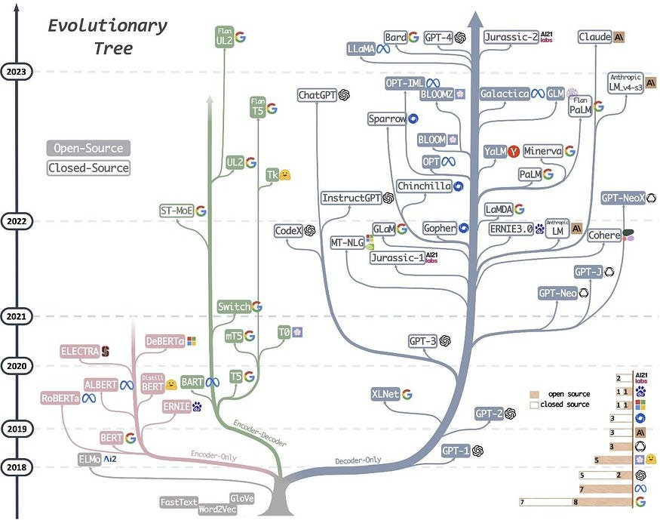
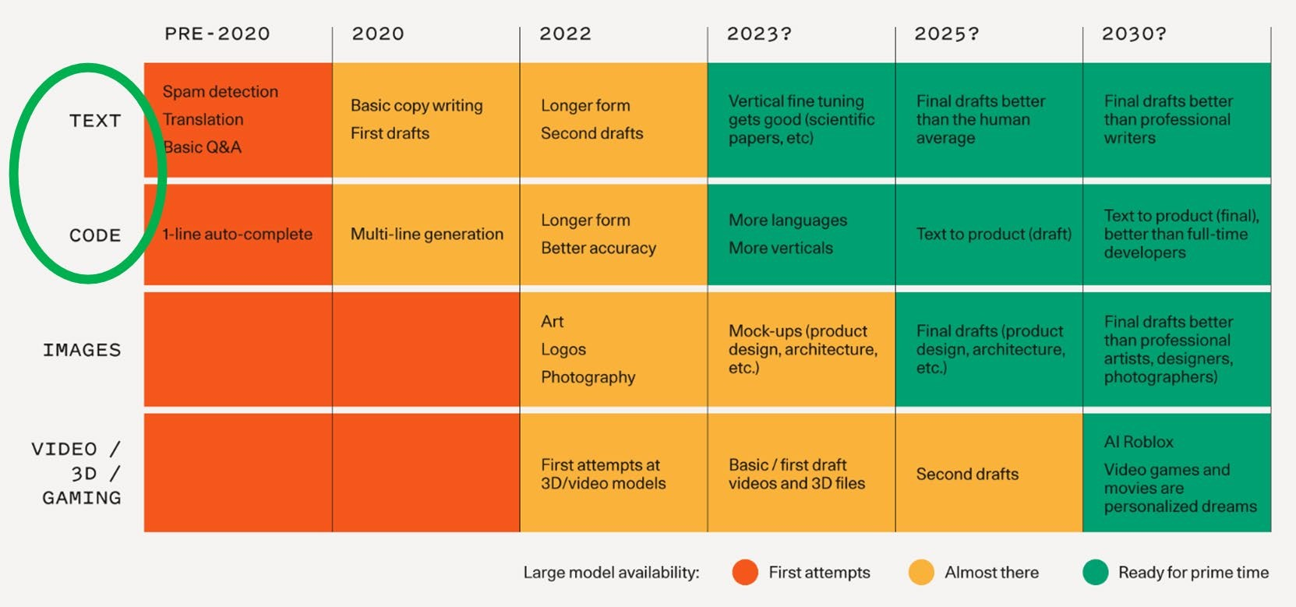
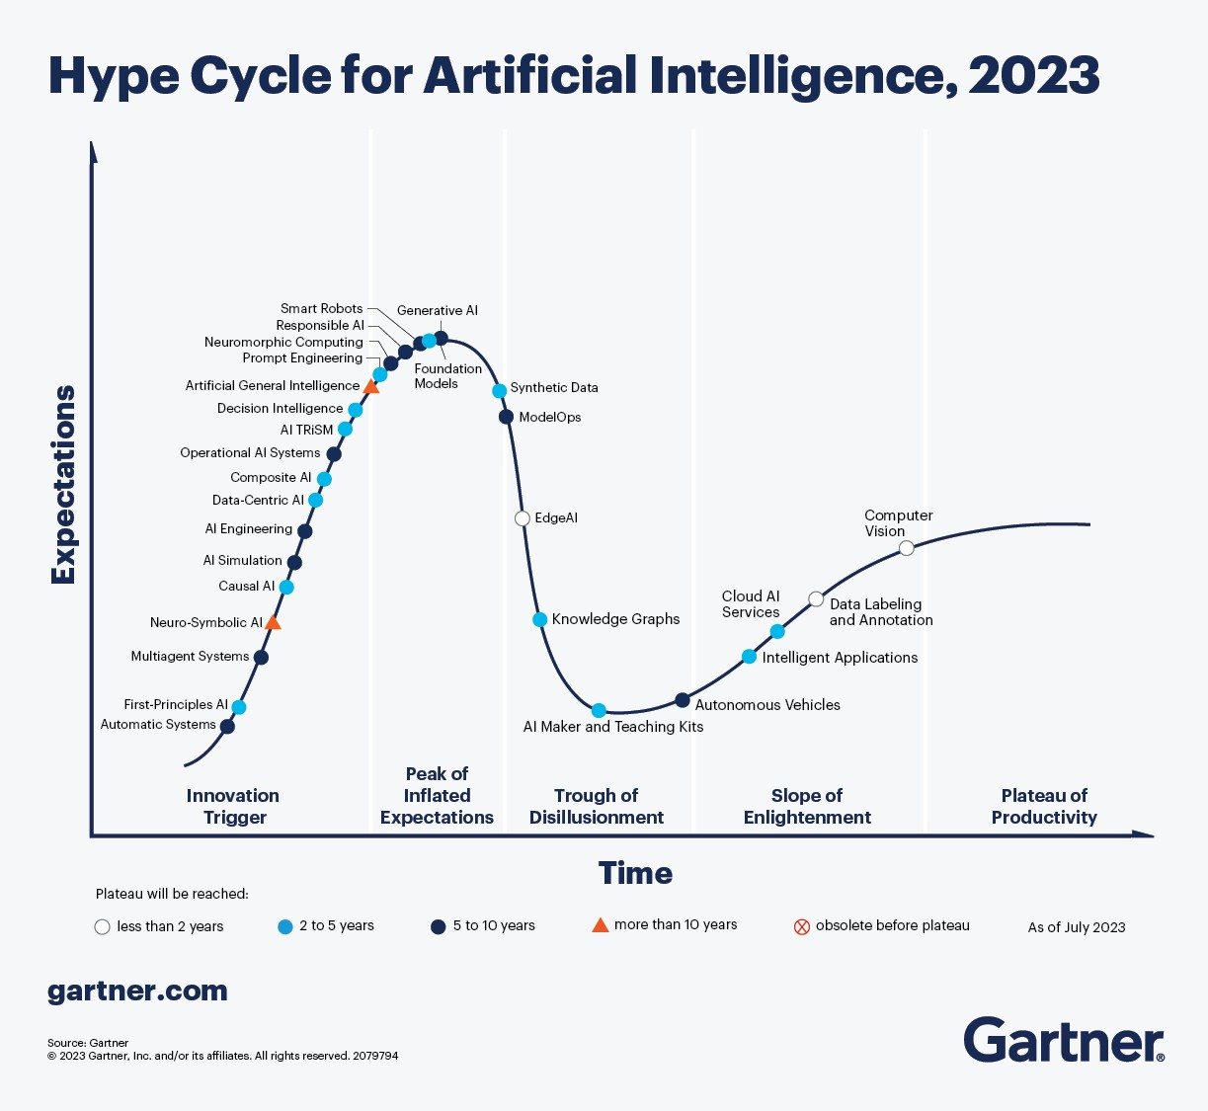
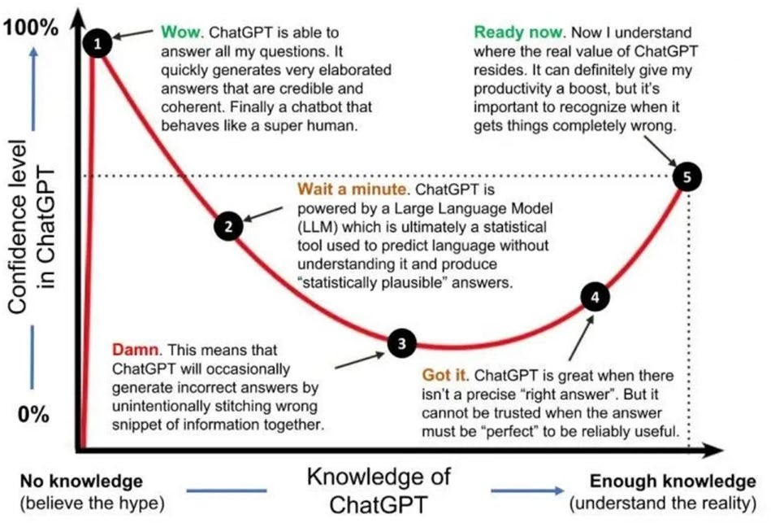
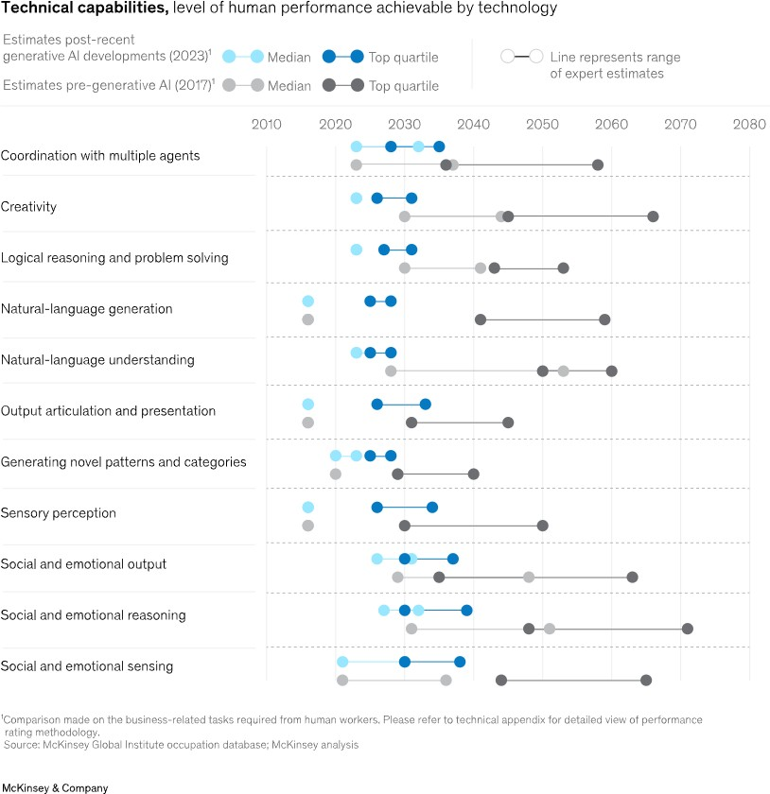
Progress in AI & LLM (Large Language Model)
How deep learning is a subset of machine learning and how machine learning is a subset of artificial intelligence (AI) https://en.wikipedia.org/wiki/Deep_learning

Slide 7
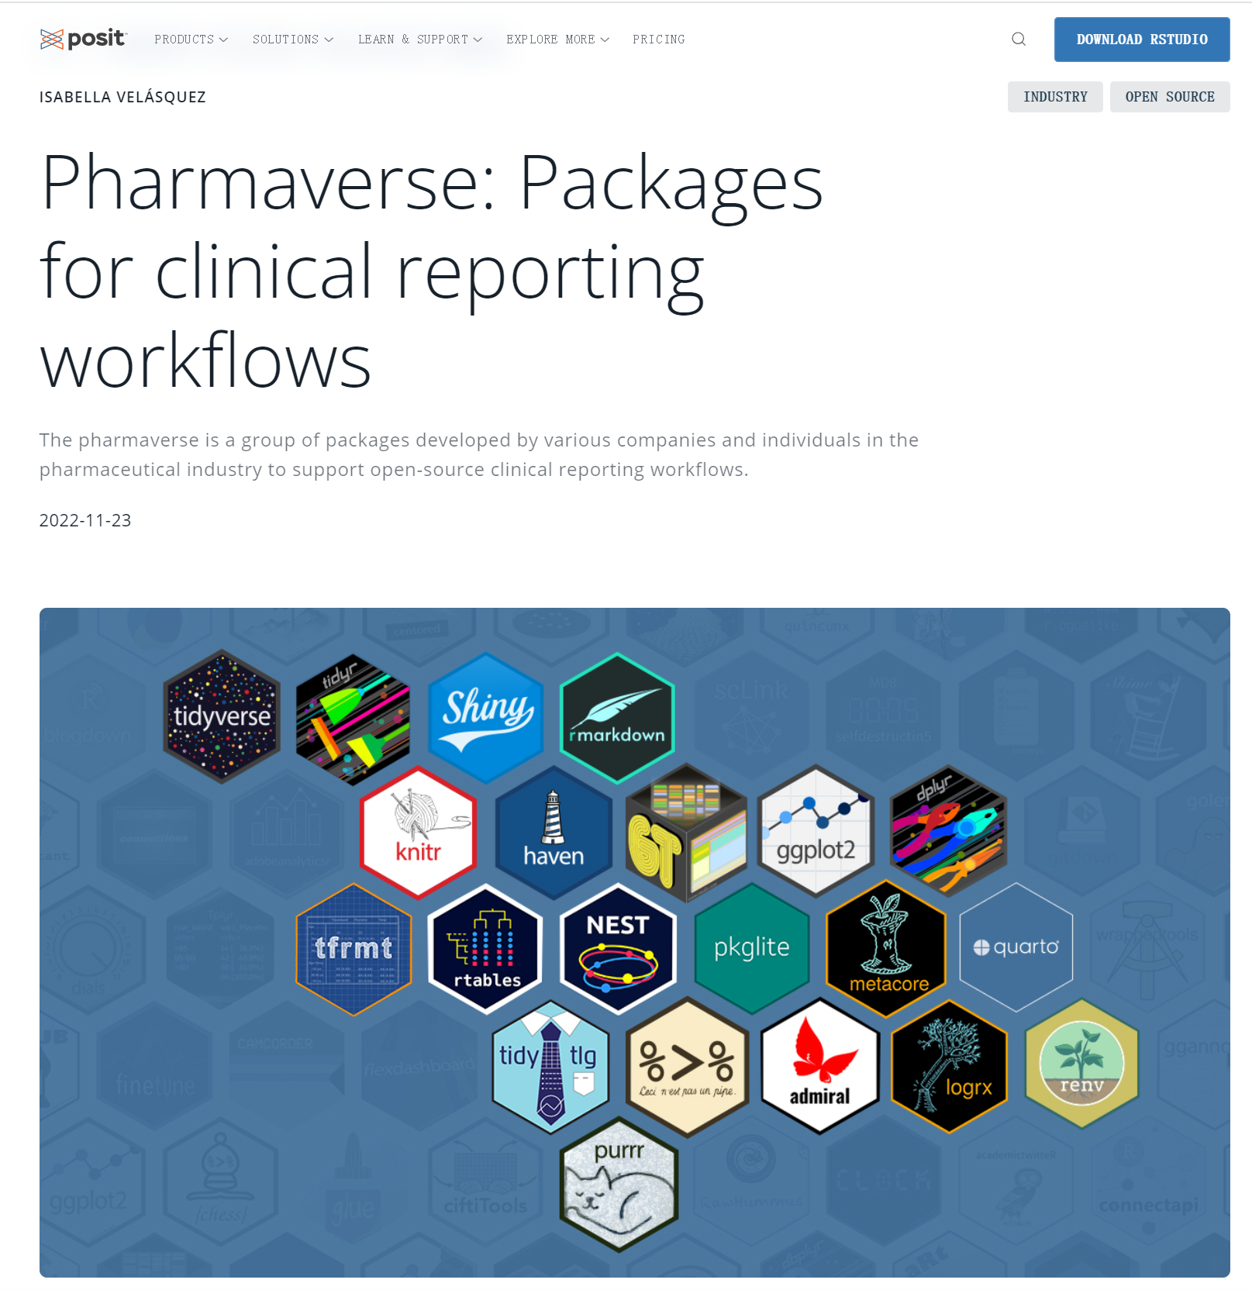
The Power of R
- Great Language for Data Analysis & Reporting
- Mature platform for data analysis and reporting developed by Posit@.
- User-friendly syntax, closely resembling natural language (e.g., Tidyverse/ggplot2）
- Widely used in the pharmaceutical industry with a thriving ecosystem.
- Open-Source
- Extensive codebase allows AI to learn and enhance capabilities.
- Enables automation of R code comprehension and generation through AI.
- Potential for developing sophisticated AI-powered R applications.
- R Shiny UI
- Superior UI framework for improved human-computer interaction.
- Integrates AI with human intelligence (AI+HI) seamlessly.
- Facilitates real-time data analysis and reporting using R in the AI+HI context.

Slide 8
Case Sharing

Slide 9
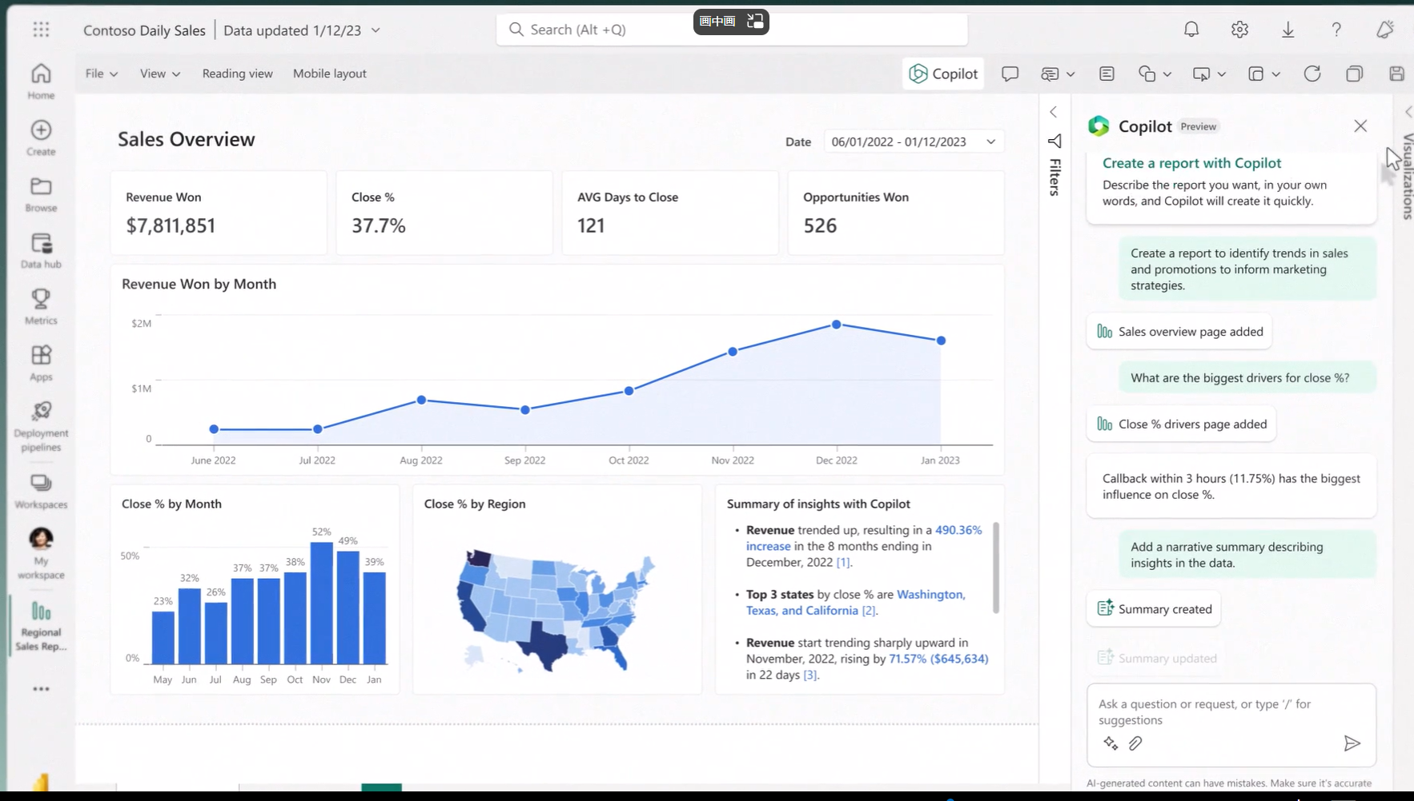
Vision
microsoft.com/en-us/videoplayer/embed/RW13t3E

Slide 10
ChatDataCopilot - Interactive Code Generation and Data Analysis Copilot
# | ​Steps | ​Note
1 | Upload testing data | Data analyzed in Rstudio Connect server, Metadata analyzed in Azure Openai/Databricks
2 | Ask your question clearly, Step by step | Start with simple questions, then proceed step by step Begin with GPT-3.5/dbrx-instruct for cost and efficiency; switch to GPT-4 (which is slow and more expensive) when necessary
3 | Review, feedback, and iteration | Continue to improve by feedback from logs and users (what’s wrong and suggestions for how to improve)
 | Restrictions | You may not be able to reproduce the code exactly, as it is driven by AI (probabilities)

Slide 11
ChatDataCopilot - Features
Basic
Real-time Data Analysis and Reporting with LLM and R
Integration of AI and Human Intelligence - Single or Multiple Rounds of Chat Support
Support for Multiple Programming Languages and Data Formats
Data Science Platform (RStudio Connect, Azure OpenAI, and Databricks)
Data Protection - All Operations Conducted in a Secure Corporate Environment
Advanced
Multi-modality – recreating reports from images of sample/mock statistical graphs/tables
Reading and understanding corporate documents/codes/metadata as knowledge base(ongoing)
Agent - continuous analysis without human intervention(ongoing)

Slide 12
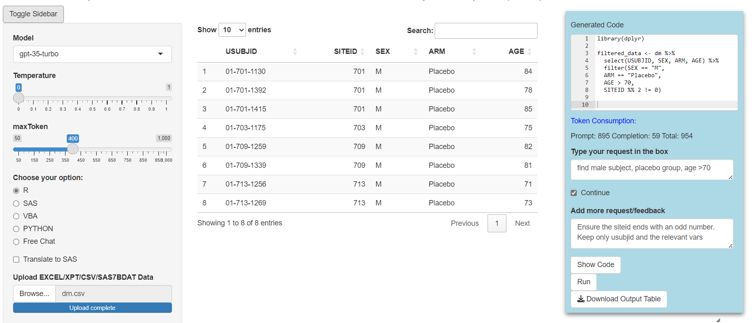
Semantic Data Query

Slide 13
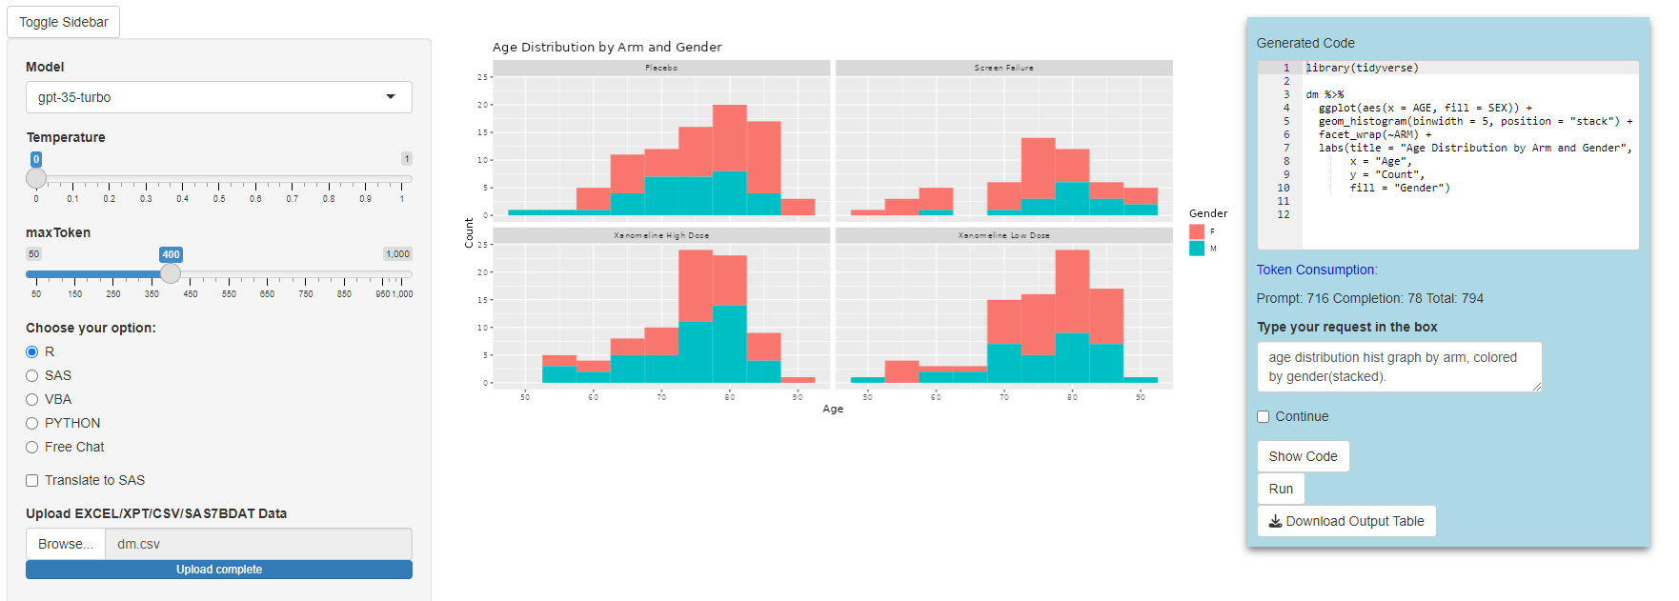
Data Visualization

Slide 14
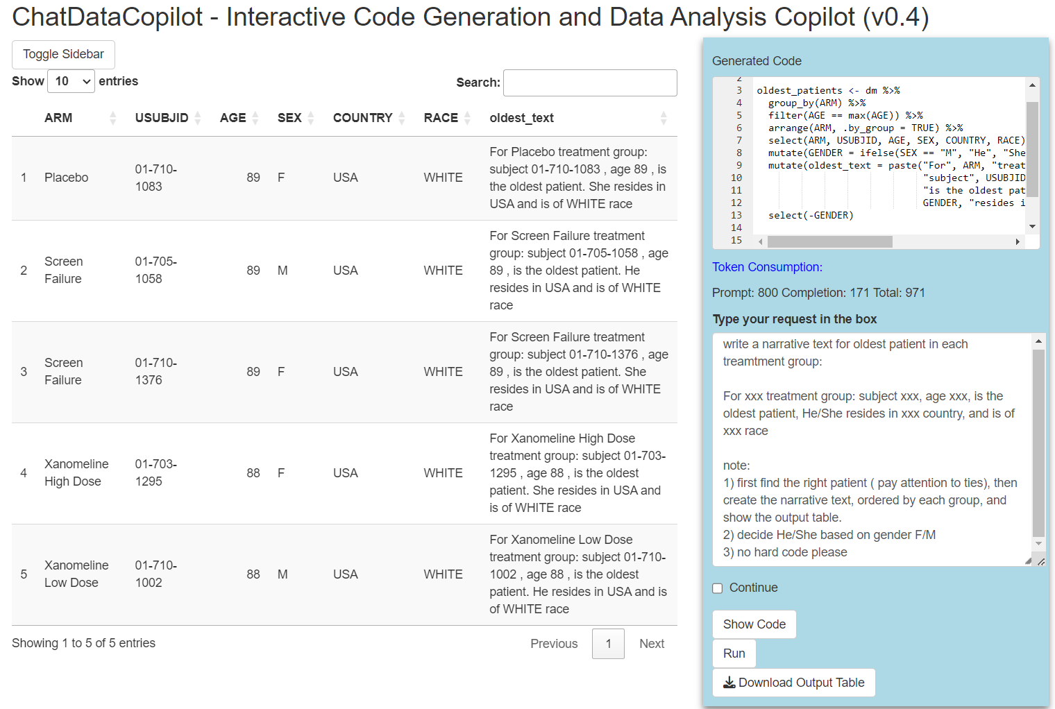
Data Query and Narrative

Slide 15
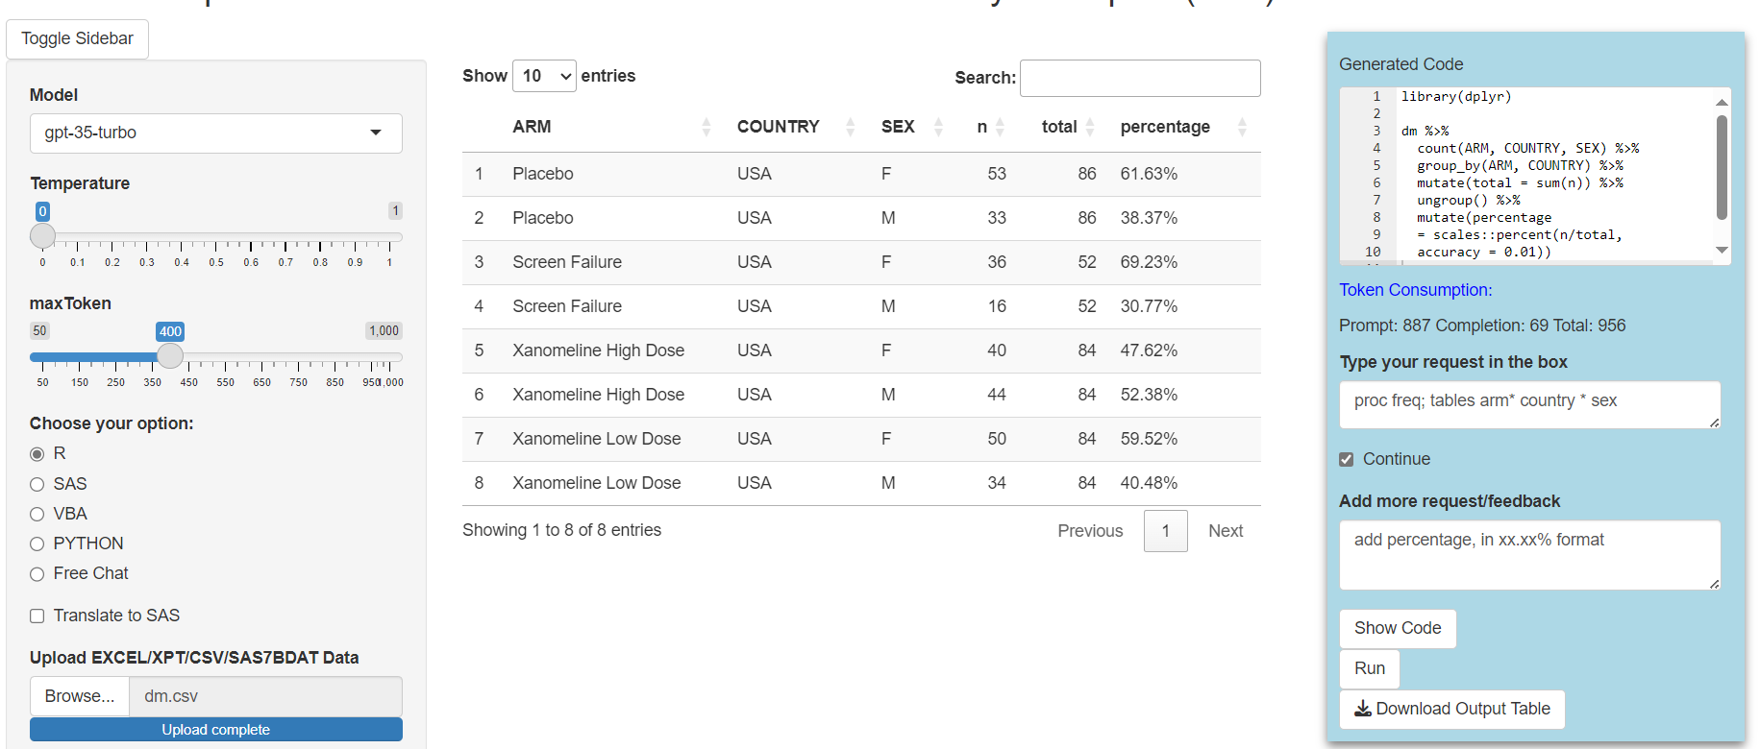
R Learning for SAS Programmer

Slide 16
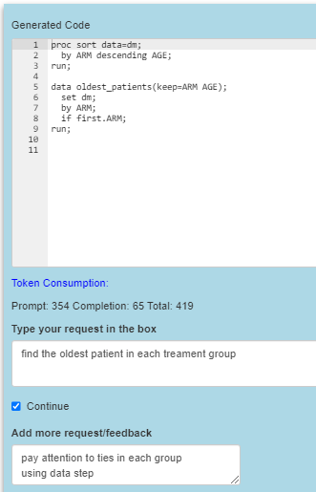
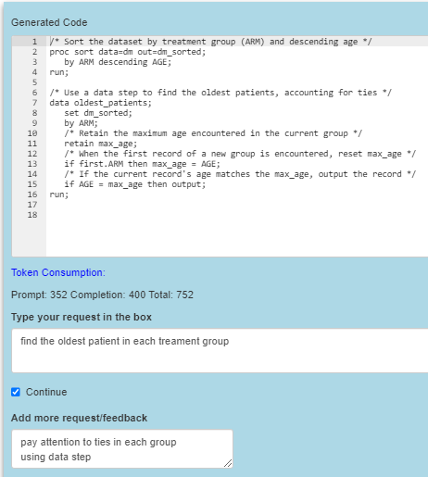
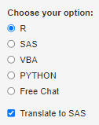
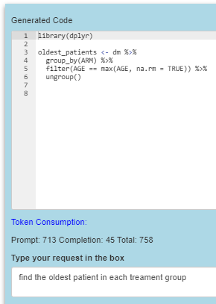
SAS Learning for R Programmer
GPT 3.5
GPT 4
✔️
❌
✔️

Slide 17
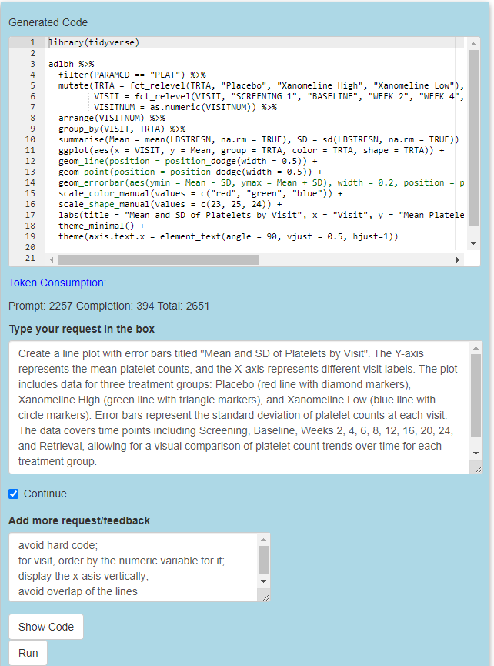
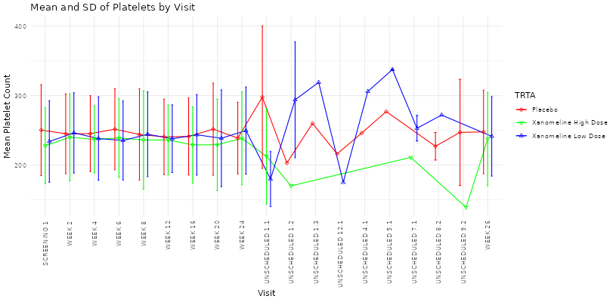
Graph Generation – from Shell Image
25

Slide 18
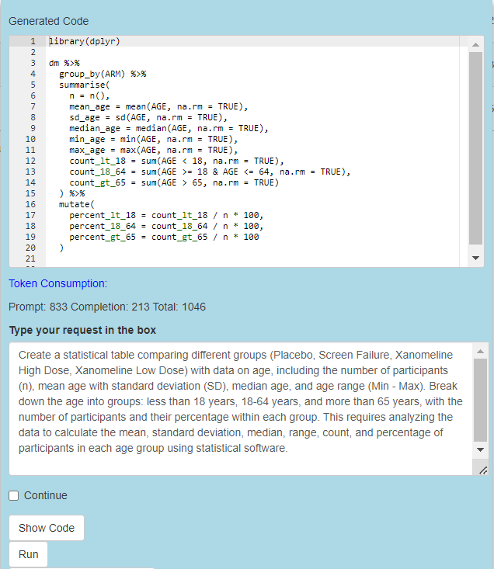
Table Generation – from Shell Image

Slide 19
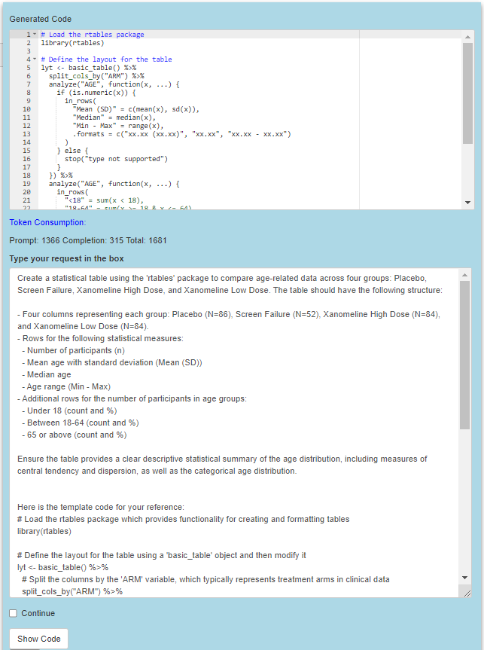
Table Generation with tool – from Shell Image

Slide 20
Discussion

Slide 21
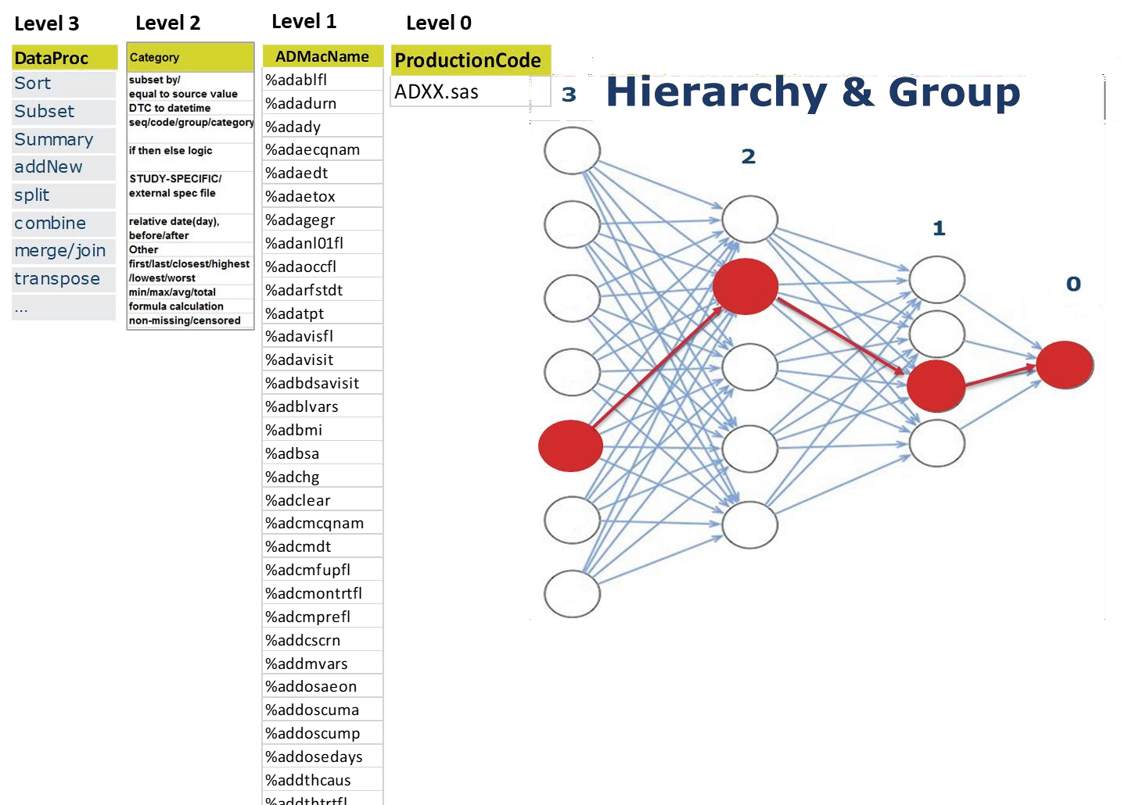
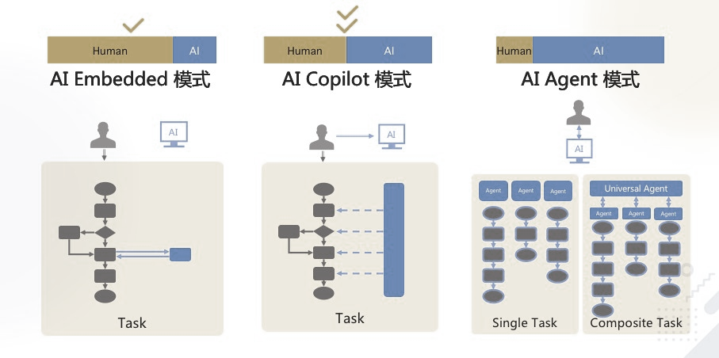
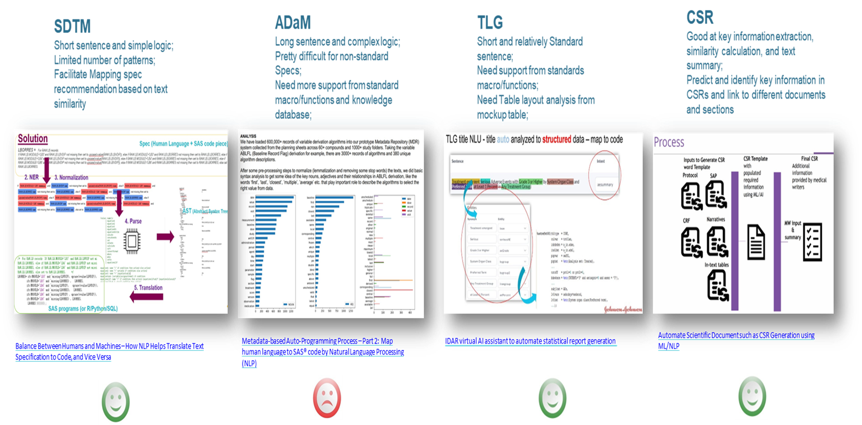
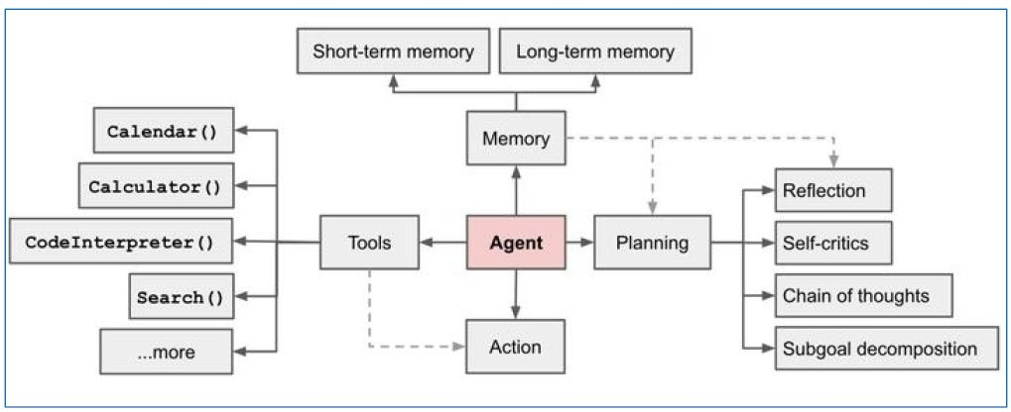
Complexity
LLM Implementation Mode

Slide 22
Q&A

Slide 23
Backup

Slide 25
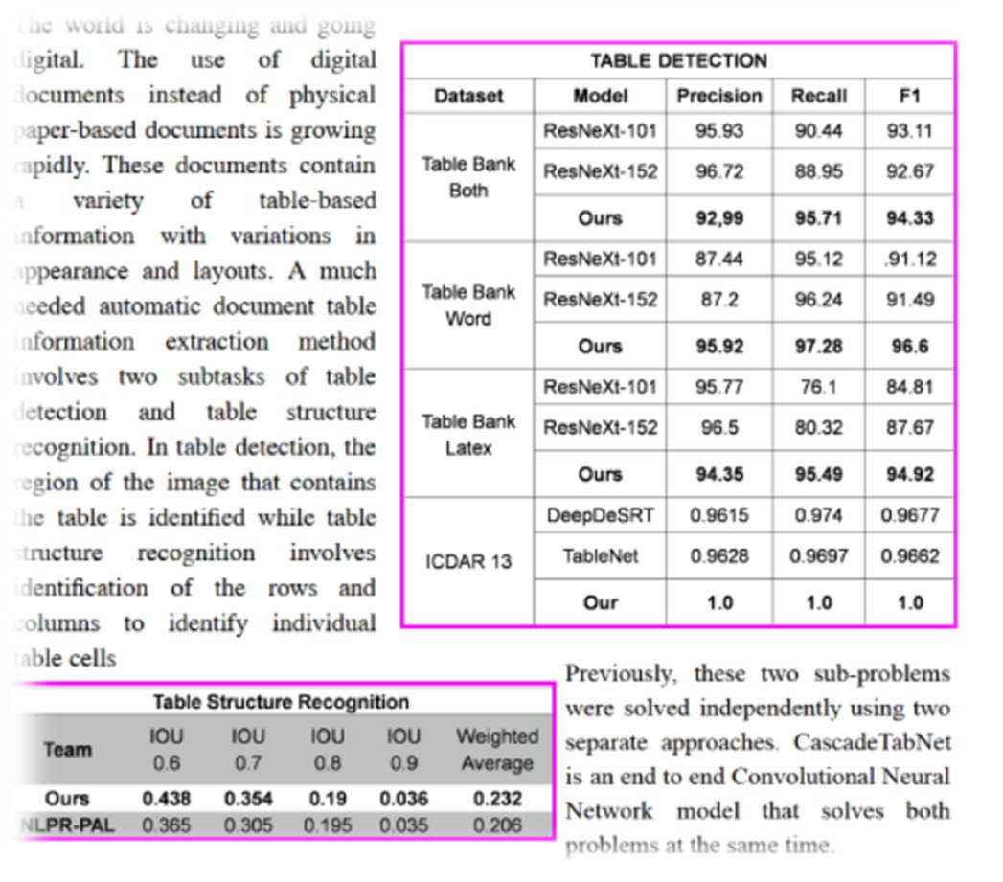
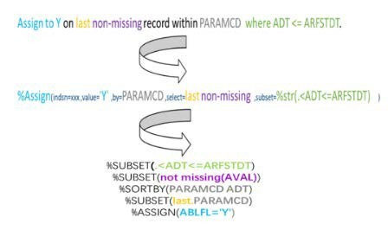
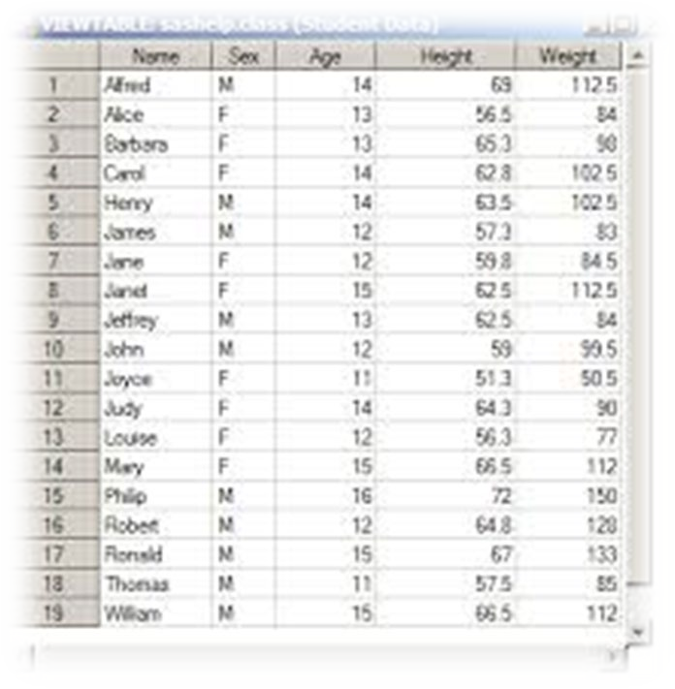
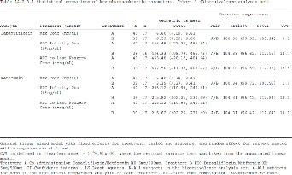
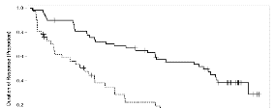
Digitalization
Text Specification

